Slide 1
Storage Assessment
DMG MEDIA LTD
Migration Evaluator-Storage Assessment
March 2026

Slide 2
Agenda
Overview(Scope)
Recommendations
Next Steps

Slide 3
Overview

Slide 4
Block Storage Volumes Overview
Volume Type- | Total Volumes | In Scope | Total Provisioned Capacity (GB) | Total Used Capacity (GB)
Virtual Machine Volumes | 3,038 | 3,038 | 1,261,914 | 758,059
Physical/Bare Metal Volumes | 0 | 0 | 0 | 0
Discovery Details and Mapping Considerations
Discovery Tool : Flat-File SAN Array/s : Block Region: eu-west-1
Block Volumes are mapped to Amazon EBS and Amazon FSxN Boot Volumes are mapped to Amazon EBS GP3 30GB of boot disks considered for all in scope servers for directional costing Detailed Volume level mapping is shared in a separate excel sheet Physical/Bare metal volumes are ones which are allocated to Physical Servers or as RDMs to Virtual Machines If Used Size is <30GB, only boot disk is mapped Please check the “Block Storage Volumes Split “ slide for split between Amazon EBS and FSxN

Slide 5
Block Storage Volumes Split – EBS and FSxN
Service Mapping | Total Volumes | In Scope | Total Provisioned Capacity (GB) | Total Used Capacity (GB)
Amazon EBS | 2,966 | 2,966 | 351,013 | 154,173
Amazon FSxN | 72 | 72 | 910,900 | 603,886
Discovery Details and Mapping Considerations
EBS Mapping 30GB of boot disks considered for all in scope servers for directional costing Data Disks are mapped to Amazon EBS GP3/SC1/ST1 and IO2 Block Express Based on the Capacity and Performance Requirements
FSxN Mapping Data volumes have been mapped to FSx for Netapp ONTAP Only Active Volumes are in scope of Target Mapping – Inactive Volumes have been mapped to capacity tier of FSxN Inactive Volumes are the ones where no IO operations were seen during the discovery period If no tags on App/DB Application Servers: SSD%: 25-100% (dynamic based on IOPS requirements) Database Servers SSD%: 100

Slide 6
Amazon EBS

Slide 7
Block Disks - Mapping to Amazon EBS
 | Current Disks |  | Boot Disks (GP3) |  | Data Disks |  | Totals
Target Volume | Volumes | Used (GB) | Count | Size (GB) | Count | Size (GB) (Data + Buffer) | Total (GB) (Boot + Data + Buffer) | Cost (Monthly) | Cost (Annual)
IO2 Block Express | 0 | 0 | 0 | 0 | 0 | 0 | 0 | $0 | $0
GP3 | 2,964 | 154,173 | 2,964 | 88,920 | 1,239 | 139,134 | 228,054 | $20,069 | $240,825
SC1 | 0 | 0 | 0 | 0 | 0 | 0 | 0 | $0 | $0
ST1 | 0 | 0 | 0 | 0 | 0 | 0 | 0 | $0 | $0
Unmapped | 0 | 0 | 0 | 0 | N/A | N/A | 0 | $0 | $0
Total | 2,964 | 154,173 | 2,964 | 88,920 | 1,239 | 139,134 | 228,054 | $20,069 | $240,825
Modelling
Intelligent capacity selection that automatically decides whether to shrink volumes or keep provisioned size
Check “AdjustedCapacityWithboot” column in the attached excel for target recommended size
30GB of boot disks considered for all in scope servers for directional costing
All boot disks are mapped to Amazon EBS GP3
See Excel for mapping against each VM
Disks with High Capacity and Performance requirements are mapped to EBS IO2 Block Express
See Excel attached
Data Export

Slide 8
Amazon FSxN Single-AZ

Slide 9
Block Disks -Amazon FSx for NetApp ONTAP
Flat-File data leveraged for storage analysis. Amazon FSx for NetApp ONTAP filesystem automatically replicates your data within AWS Availability Zone (AZ) for high availability and durability. The prices below are based on a Single-AZ Amazon FSx for NetApp ONTAP deployment.
Parameter | Pricing (Monthly)
Boot Disks Amazon EBS GP3: 72 Provisioned capacity: 2,160 GB | $190
SSD storage Provisioned SSD capacity: 405,597 GB | $55,972
Additional SSD IOPS Additional SSD IOPS over-provisioned: 0 IOPS | $0
Capacity pool storage Average capacity pool storage: 33,095 GB | $725
Throughput capacity Provisioned throughput: 6,144 MB/s | $11,102
Total Monthly Cost (Including Boot) | $67,989
Total Annual Cost (Including Boot) | $815,873
Considerations
90% SSD Usable Considered (Best Practice)
10% Space added to SSD pool
10% of SSD Tier Space is considered for System space
Space added to SSD Pool
3% of Capacity Space is added as meta data to SSD Pool
Snap Reserve: 10%
Savings from Compression + Deduplication: 45%
Modeling
Total Used Storage Capacity: 603,886 GB
Total Used Storage Capacity(FSx): 438,692 GB
Percentage of data on SSD Storage: 92.46 %
Percentage of data on Capacity Pool: 7.54 %
IOPS: Default
* SSD Provides 3 IOPS per GB
Throughput capacity: 6,144 MBps
Region – eu-west-1
# of FSx Filesystems: TBD
Architecture: GEN2
HA PAIR: 2
Protocols: iSCSI
Volumes: Please see the excel attached for In-Scope Volumes

Slide 10
Thank you

Slide 11
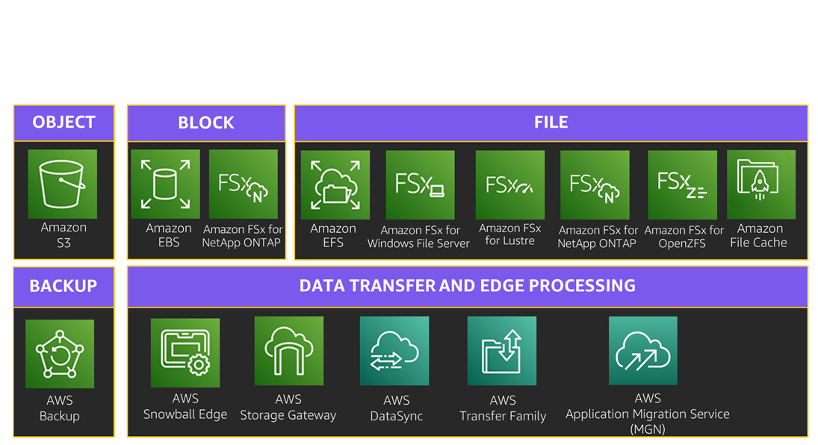
Next Steps after a Storage Assessment
Engage your AWS Account team
Identify candidates for POC
AWS Storage Services Setup
Recommendation for Migration Tools/Methodologies
Migration Planning – Move Groups
Helpful Links
Cloud Storage on AWS
AWS Migration Acceleration Program
AWS DataSync
Migrate to FSx for ONTAP using NetApp SnapMirror
Migrate existing file storage to Amazon FSx for Windows
Migrating to Amazon FSx for OpenZFS
Migrating to Amazon FSx for Lustre using AWS DataSync
Transferring data into and out of Amazon EFS
Save Up to 66% by Migrating to AWS Cloud Infrastructure
Optimize AWS Storage usage
AWS is constantly adding new capabilities so you can leverage the latest technologies to experiment and innovate more quickly. What's New posts show how we are doing just that, providing a brief overview of all AWS service, feature, and region expansion announcements as they are released.
What's New with Storage?
Contact: aws-storage-specialists-all@amazon.com

Slide 12
Simplify your SQL Server HA Deployments using Amazon FSx
Run storage assessment for your SQL DB
Know your storage capacity and performance needs
Map to the right fully managed file system
Right size target file system
Directional pricing for Single-AZ & Multi-AZ
Know your SQL backup costs
Amazon FSx for Windows File Server (FSxW) uses a native Windows OS using Microsoft’s SMB file share protocol. FSxW provides multi-attach to multiple SQL nodes, multi-AZ deployment for HA, configurable and dynamic throughput for performance, continuously available (CA) shares to ensure SQL servers fail over, Windows-based snapshots, and FSx backups to S3. You can provision up to 64GB of SSD storage and 12 GB/s of throughput per file system.
Amazon FSx for NetApp ONTAP (FSxN) provides shared file (SMB) and block (iSCSI) storage. It provides multi-attach to multiple SQL nodes, multi-AZ deployment for HA, configurable throughput and IOPS for performance, CA shares, NetApp snapshots (SQL integration), FSx backups to S3, replication (ie, to other regions for DR), and cloning (for test/dev). You can provision up to 192GB SSD and 4 GBps of throughput per file system.
Helpful Links
Simplify your Microsoft SQL Server high availability deployments using Amazon FSx for Windows File Server
SQL Server High Availability Deployments Using Amazon FSx for NetApp ONTAP
Video
Microsoft SQL high availability with Amazon FSx for Windows
Email at migration-assessment@amazon.com for further questions and to run a storage assessment for SQL workloads

Slide 13
Reduce TCO by Moving to AWS
You need to reduce costs
Data center space, power, cooling
Network
Hardware, software maintenance
Human resources
Retrieval
Under utilization
Request
Migration
Data transfer
Direct
storage
On Premises
AWS

Slide 14
Amazon EBS Recommendations
Start with smaller EBS volume sizes, with enough capacity to meet your immediate needs. You can then expand volume sizes with Elastic Volumes if your requirements increase. Shrinking the size of a volume is a manual process.
Start with General Purpose GP3 volumes when you're uncertain if your applications require higher performing IOPS or throughput volumes. GP3 volumes are estimated to be appropriate for up to 80 percent of workloads.
Start with lower provisioned IOPS levels for IO2 volumes. You can increase or decrease the provisioned IOPS level as you understand your workload performance and fine-tune your volumes.
Use current EBS volume types. Generally, newer volume types support greater functionality at a lower cost. For example, with GP3 volumes, you can provision IOPS and throughput without expanding your volume in many cases. With GP2 volumes, you could only increase performance by increasing the volume size. Additionally, GP3 volumes cost less per GB per month than GP2 volumes.
Choose the best Amazon EBS volume type for your self-managed database deployment
RAID 5 and RAID 6 are not recommended configurations when using Amazon EBS because the parity write operations of these RAID modes consume some of the IOPS available for your volumes. Depending on the configuration of your RAID array, these RAID modes provide 20-30% fewer usable IOPS than a RAID 0 configuration. Increased cost is a factor with these RAID modes as well; when using identical volume sizes and speeds, a 2-volume RAID 0 array can outperform a 4-volume RAID 6 array that costs twice as much.
RAID 1 is also not recommended for use with Amazon EBS. RAID 1 requires more Amazon EC2-to-Amazon EBS bandwidth than non-RAID configurations because the data is written to multiple volumes simultaneously. In addition, RAID 1 does not provide any write performance improvement.
Amazon EBS ST1 and SC1 are mapped based on performance discovery. It is assumed that the workloads have large sequential IO requirements. Please use Amazon EBS GP3 volumes for small random IO workloads.
Amazon EBS Snapshots Archive is a new storage tier that you can use for low-cost, long-term storage of your rarely-accessed snapshots that do not need frequent or fast retrieval.

Slide 15
Amazon EBS- IO2 BX vs GP3
Volume Type | Use Case | Capacity | Latency | Durability | Max IOPS | Max Throughput | Other Considerations
Amazon EBS IO2 Block Express | Mission-critical, large, performance-sensitive workloads requiring sub-millisecond latencies | 4 GiB – 64 TiB | Consistent sub-millisecond latency Lowest EBS outlier latency | 99.999% durability | 256,000 IOPS (16 KiB I/O) Sustained IOPS performance | 4000 MiB/S | Multi Attach Persistent Reservation
Amazon EBS GP3 | -Transactional workloads -Virtual desktops -Medium-sized, single-instance databases -Low-latency interactive applications -Boot volumes -Development and test environments | 1 GiB – 16 TiB | Single digit millisecond Latency | 99.8%-99.9% durability | 16,000 (16 KiB I/O) | 1000 MiB/s | If striping gp3 volumes to achieve increased I/O and throughput performance relative to IO2, additional management of RAID 0 volumes

Slide 16
Amazon FSx for NetApp ONTAP- Useful Links
Amazon FSx for NetApp ONTAP FAQs
https://aws.amazon.com/fsx/netapp-ontap/faqs/
Choosing Storage Capacity
https://docs.aws.amazon.com/fsx/latest/ONTAPGuide/choose-ssd-capacity.html
FSx for NetApp ONTAP File Server performance
https://docs.aws.amazon.com/fsx/latest/ONTAPGuide/performance.html
Increasing SSD storage capacity dynamically
https://docs.aws.amazon.com/fsx/latest/ONTAPGuide/increase-primary-storage.html#automate-storage-capacity-increase
Volume data tiering
https://docs.aws.amazon.com/fsx/latest/ONTAPGuide/volume-data-tiering.html
https://www.netapp.com/pdf.html?item=/media/17239-tr-4598.pdf
Migrating to FSx for ONTAP using NetApp SnapMirror
https://docs.aws.amazon.com/fsx/latest/ONTAPGuide/migrating-fsx-ontap-snapmirror.html
Migrating to FSx for ONTAP using AWS DataSync
https://docs.aws.amazon.com/fsx/latest/ONTAPGuide/migrate-files-to-fsx-datasync.html
Working with Snaplock
https://docs.aws.amazon.com/fsx/latest/ONTAPGuide/snaplock.html
https://www.netapp.com/pdf.html?item=/media/6158-tr4526pdf.pdf

Slide 17




Amazon FSx for NetApp ONTAP- Configurations
Single-AZ
Multi-AZ
AWS Cloud
AWS Cloud
AWS Cloud
Availability Zone 1
Availability Zone 1
Availability Zone 2
ONTAP server
ONTAP server
ONTAP server
ONTAP server
Test/Dev, DR, and workloads with Replication between nodes within an AZ 11 x 9’s durability for capacity pool and backups Equal or better availability and durability than a single datacenter implementation
Production workloads with Replication between nodes between two AZs 11 x 9’s durability for capacity pool and backups Equal or better availability and durability than a multi-datacenter implementation

Slide 18
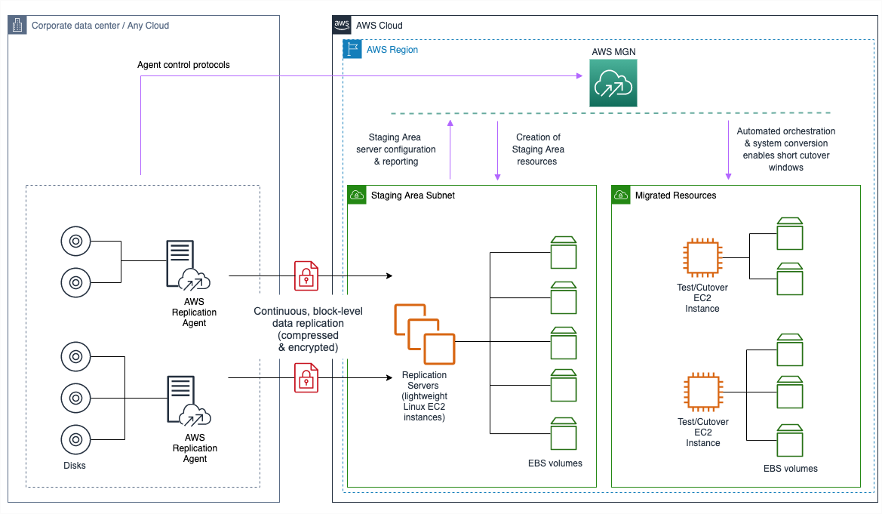
How MGN Migration Works
Continuously replicates any application or database from any source into AWS
Business outcome: self-service, rapid, reliable migrations with minimal business disruption

Slide 19
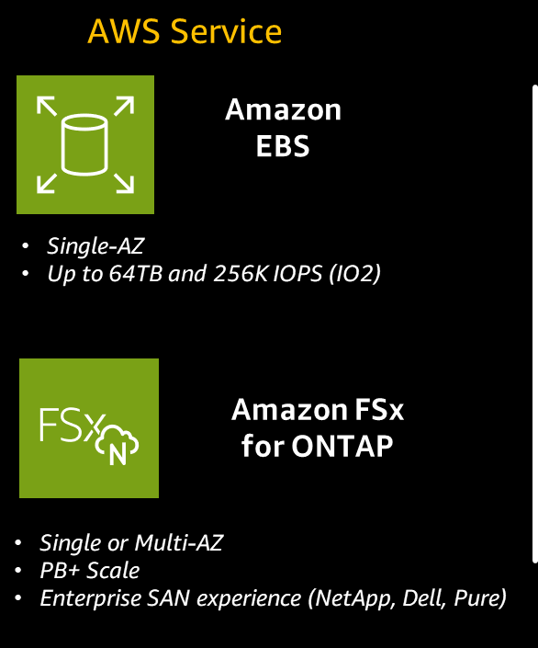

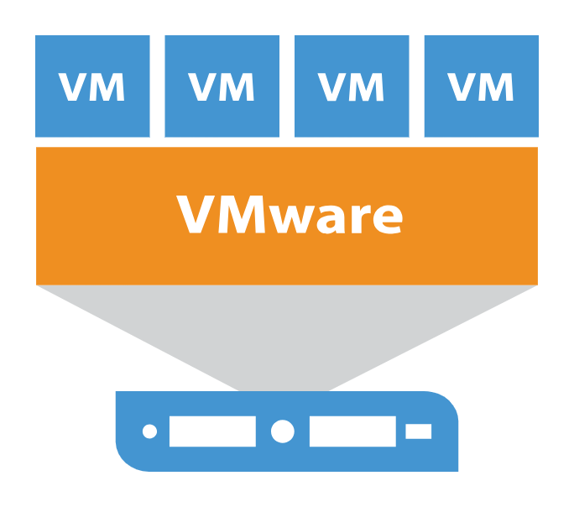
Migrate VMware Storage to Amazon EBS + FSxN
For IT & Line-of-Business applications and databases (SQL, SAP HANA, Oracle)
VM Storage from vSAN, SAN/Block Storage over NFS/FC/iSCSI
Seamless migration from any VMware environment to Amazon FSx for NetApp ONTAP and Amazon EC2

Slide 20

Optimizing performance at scale - GEN 2 File Systems
Active-Passive configuration
Auto-scaling group and compute clusters
Up to 2.4M IOPS at sub-millisecond latency
…
Up to 72 GBps of network throughput
A
P
A
P
A
P
A
P
…
Up to 1 PiB of SSD storage
SSD storage capacity and SSD IOPS can be increased
Throughput is determined by the number of HA pairs configured

